Slide 1


Bellabeat Case Study
By Pankaj Kumawat
Date: 29/07/2022

Slide 2
About The Company
Bellabeat is a high-tech company that manufactures health-focused smart products. Founded in 2013 by artist Urška Sršen and mathematician Sando Mur, the company has many products carefully designed to monitor activity, stress, sleep, and reproductive data to help women better understand how their bodies work and make healthier choices. While small in size, Bellabeat has quickly positioned itself as a tech-driven wellness company for women. Chief Creative Officer, Urška Sršen, believes that analyzing smart device fitness data could help unlock new growth opportunities for the company.

Slide 3
Business Task
Focus on one of Bellabeat’s products and analyze smart device data to gain insight into how consumers use non-Bellabeat smart devices.

Slide 4


Products
Bellabeat app
Leaf
Time
Spring

Slide 5
Stakeholders
Urška Sršen – Bellabeat’s cofounder and Chief Creative Officer.
Sando Mur – Mathematician and Bellabeat’s cofounder; key member of the Bellabeat executive team.Nunc Viverra
Bellabeat marketing analytics team – A team of data analysts responsible for collecting, analyzing, and reporting data that helps guide Bellabeat’s marketing strategy.

Slide 6
Phases of Analysis
Ask
Prepare
Process
Analyze
Share
Act

Slide 7
Ask
What are some trends in smart device usage?
How could these trends apply to Bellabeat customers?
How could these trends help influence Bellabeat marketing strategy?

Slide 8
Prepare
Urška Sršen encourages the use of public data that explores smart device users’ daily habits. Therefore, the dataset used in this project will be the FitBit Fitness Tracker Data (CC0: Public Domain, dataset made available through Möbius).

Slide 9
Process
Data Processing involves making data consistent, reliable for further analysis.
Python is used for the data processing.

Slide 10
Analyze
This phase involves data transformation, change data formatting and merging in order to perform analysis.
Aggregation and grouping of data is also done in this phase to answer question and perform calculations.

Slide 11
Analyzing the Average of Total Steps and Calories
Average daily total steps are 7638.
Average daily total calories burnt are 2303
According to a study conducted in 2011 by BMC/BioMed Central, taking 10,000 steps a day is a reasonable target for healthy adults, helping reduce certain health conditions, such as high blood pressure and heart disease.

Slide 12
Analysing sleep data
Average daily sleep time is 419 min that is almost 7 hours.
According to studies an adult between 18-60 should get 7 or more hours sleep. Therefore we can conclude that they have good sleeping habits.

Slide 13
Share
This phase include visualization of the information we got after analyse phase.
Python is used for visualization.

Slide 14
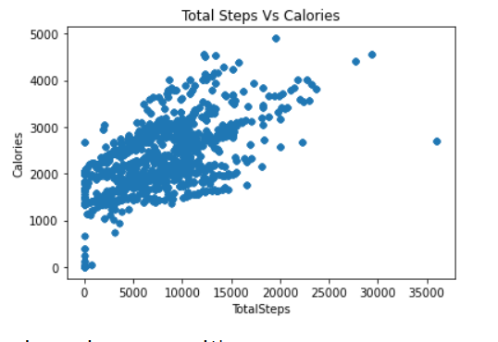
Total Steps Vs Calories
We can see there is a positive correlation between number of steps and calories burnt.
Therefore we can say number of steps taken by individual will have direct impact on health.

Slide 15
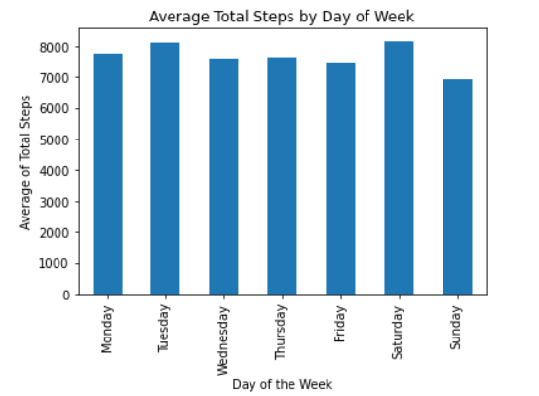
Average number of steps on each day of week
Most active days in terms of number of steps are Saturday followed by Tuesday.
There is no drastic change in number of steps through out the week.

Slide 16
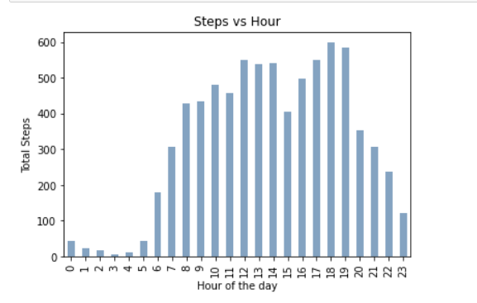
Number of steps through out the day
This chart shows that the users tend to start their day around 6 am and remain active through out the day .
There is a dip in number of steps at 3 Pm and after that number of steps increasing till 7, this is probably due to workout.

Slide 17
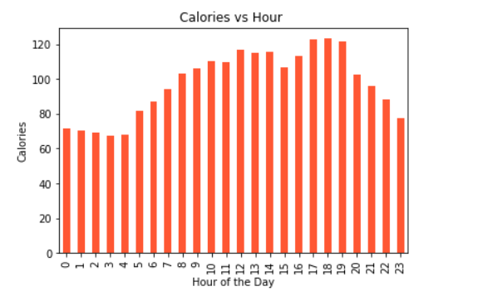
Calories by the time of Day

Slide 18
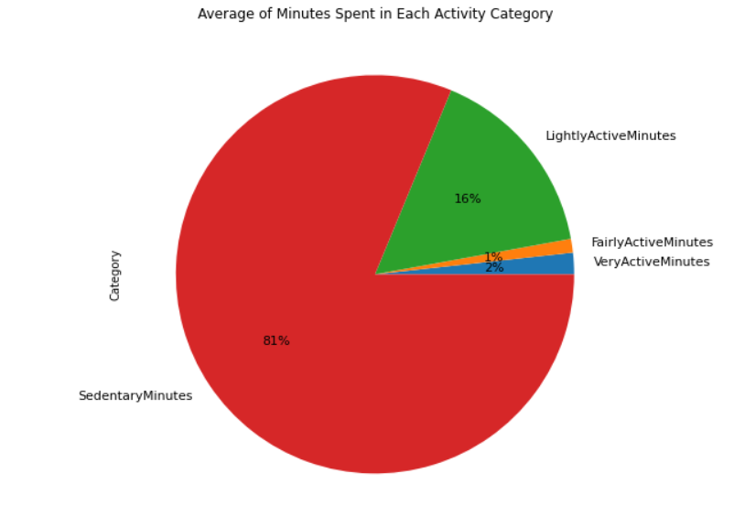
Average of Minutes Spent in Each Activity Category
At least 30 minutes of moderate daily physical activity is recommended by Department of Health and Human Sciences.
Our users are very active for over 30 minutes every day, but they are spending enormous amount of time being sedentary, which could result in future health issues.

Slide 19
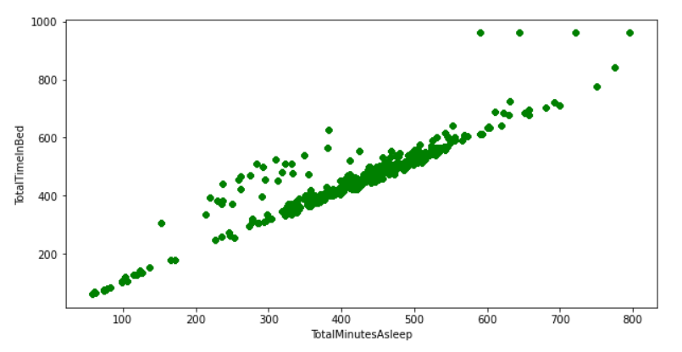
Total Time in Bed Vs Total Minutes Asleep
As we can see that there is strong correlation between total time in bed vs total sleeping time.
Though some point can be seen when total time in bed is more, These point may be the points corresponding to the data on weekends.

Slide 20
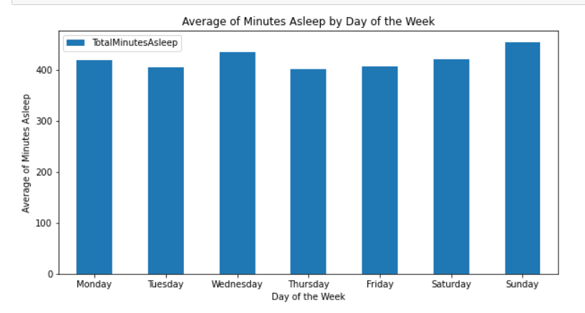
Average of Minutes Asleep by Day of the Week
It is clear from the visualization that there is no significant change in sleeping duration throughout the week.

Slide 21
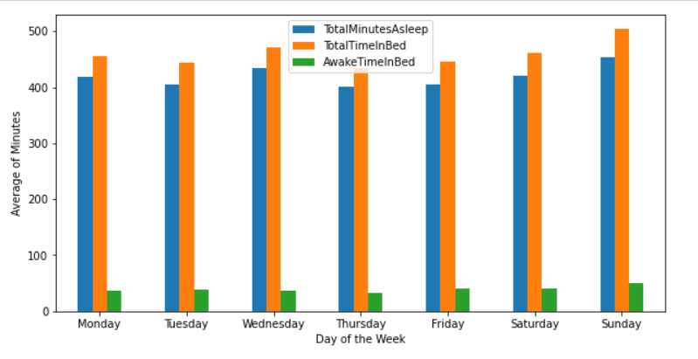
Visualizing Awake Time in Bed by day of the Week
As we can see, the users are very consistent with their time in bed throughout the days of the week, and the same goes for the time they are awake in bed. From their total time in bed, they spend, on average, 39.5 minutes awake. The longest recorded times occurred on the weekend, which is perfectly understandable.

Slide 22
Act Key Findings
The average user takes 7,638 steps and burns 2,304 calories per day.
There is a positive correlation between the total number of steps and the total number of calories burned.
The users seem to be consistent with their total steps throughout the week. The most active day is Saturday, and the least active is Sunday.
The users start their day between 6 am and 8 am. They are most active between 5 pm and 7 pm, and become less active at 8 pm.
The highest number of burned calories occur between 5 pm and 7 pm, when the users are most active.
Although the average user is very active for over 30 minutes every day, they still spend 81% of their time being sedentary.
There is a strong, positive relationship between the total number of minutes asleep and the total time spent in bed, with users only spending an average of 39.5 minutes of their total time in bed being awake.
The users have a consistent sleeping schedule, with an average sleeping time of 419.8 minutes (or 7 hours) per night - with Sunday (7.6 hours) being the day where the users seem to have slept the most.
Recording the lowest number of steps and the highest number of minutes asleep, Sunday is likely a rest day chosen by the users.

Slide 23
Recommendations
Personalized notification system to promote the activity. According to our findings we noticed that average users’ steps is 7638, but it should be around 10000 steps in a day. Apart from this there can be a notification system to promote some activity after a period of sitting.
The app can be modify to keep users motivate to do workout. There can be a reward system within app to do so.
A feature can be added in the app through which users can compete with other people this will keep them motivate.
Bellabeat can also sell it’s product on discount to get new customes.

Slide 24
Thank you!!

